Slide 1
Linear Model
Ying shen
Sse, tongji university
Sep. 2016

Slide 2
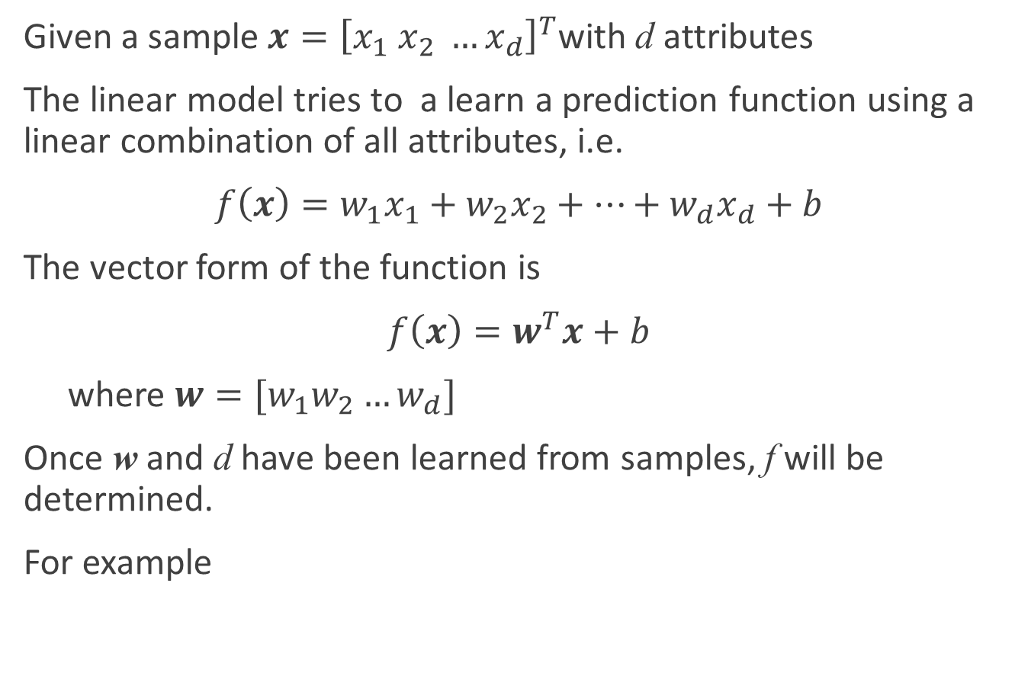
The basic form of the linear model
Given a sample $x={\left[x_{1} x_{2} …x_{d}\right]}^{T}$with d attributes
The linear model tries to a learn a prediction function using a linear combination of all attributes, i.e.
$f\left(x\right)=w_{1}x_{1}+w_{2}x_{2}+…+w_{d}x_{d}+b$
The vector form of the function is
$f\left(x\right)=w^{T}x+b$
where $w=[w_{1}w_{2}…w_{d}]$
Once w and d have been learned from samples, f will be determined.
For example
$$f_{好瓜}=0.2∗x_{色泽}+0.5∗x_{根蒂}+0.3∗x_{敲声}+1$$

Slide 3

Linear regression
Given a dataset $D=\left\{\left(x_{1},y_{1}\right),\left(x_{2},y_{2}\right),…,\left(x_{m},y_{m}\right)\right\}; x_{i}={\left[x_{i1},x_{i2},…,x_{id}\right]}^{T}$, the task of a linear regression is to learn a linear model which can predict a value that close to y' given a sample x'.
When $d=1$, $x_{i}=x_{i}$
Hours Spent Studying | 4 | 9 | 10 | 14 | 4 | 7 | 12 | 22 | 1 | 3 | 8
Math SAT Score | 390 | 580 | 650 | 730 | 410 | 530 | 600 | 790 | 350 | 400 | 590

Slide 4

Linear regression
We will learn a linear regression model
$f\left(x_{i}\right)=wx_{i}+d, such that f(x_{i})≅y_{i}$
How do we determine w and b?

